Slide 1
Care Management Software
Bidder’s Conference
December 14, 2016
Michelle.Rubin@crisphealth.org

Slide 2
Agenda
CRISP Website – RFP Information
Overview of CRISP
CRISP Architecture
Expectations of a Care Management Tool
RFP Timeline
Review Pricing Model File
Q&A

Slide 3
CRISP Website
https://crisphealth.org/
https://www.crisphealth.org/basic-care-management-software-vendor-rfp/

Slide 4
Who We Are
CRISP is a regional health information exchange (HIE) serving Maryland and the District of Columbia. We are independent not-for-profit membership corporation advised by a wide range of stakeholders who are responsible for healthcare throughout the region. CRISP has been formally designated as Maryland's statewide health information exchange by the Maryland Health Care Commission.
Notes:
Source: https://crisphealth.org/about/

Slide 5
Our Mission
We will enable and support the healthcare community of Maryland and our region to appropriately and securely share data in order to facilitate care, reduce costs, and improve health outcomes.
Notes:
Source: https://crisphealth.org/about/

Slide 6
Our Vision
To advance health and wellness by deploying health information technology solutions adopted through cooperation and collaboration.
Notes:
Source: https://crisphealth.org/about/

Slide 7
Our Guiding Principles
Begin with a manageable scope and remain incremental.
Create opportunities to cooperate even while participating healthcare organizations still compete in other ways.
Affirm that competition and market-mechanisms spur innovation and improvement.
Promote and enable consumers’ control over their own health information.
Use best practices and standards.
Serve our region’s entire healthcare community.
Notes:
Source: https://crisphealth.org/about/

Slide 8
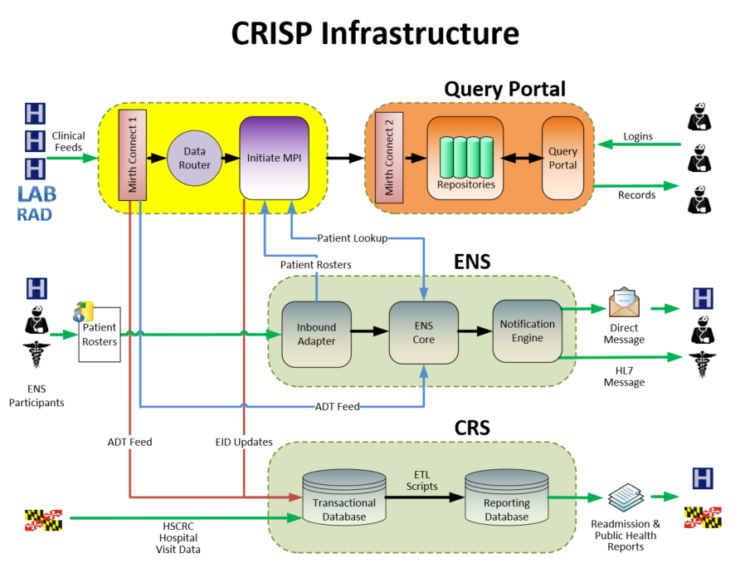
CRISP Architecture- Current State

Slide 9
Goals for a Care Management Tool
Support new payment models and emerging programs
CCIP: hospital/provider relationship for care management
Advanced Payment Models for hospitals and PCPs
Allow care managers to care for high risk and rising risk patients across the healthcare system
Care Plan Development, manage care teams, document contact with patient/providers/care providers, health risk assessments, task management
Meaningful data exchange between CRISP and care management platform

Slide 10
CRISP Architecture- Future State

Slide 11
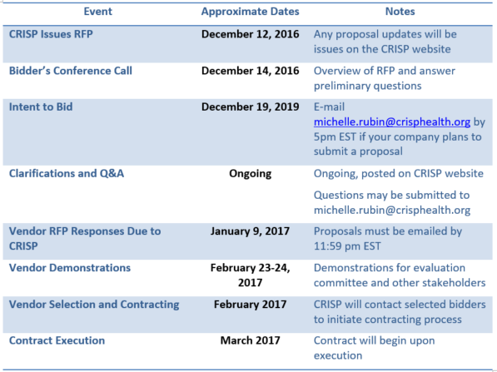
Timeline

Slide 12
Questions?
Contact Michelle Rubin
Michelle.Rubin@crisphealth.org
All questions and answers will be posted to CRISP’s website.

